Slide 2







Welcome to
BEAUTY OF BEACHES

Slide 3
E-Project
BEAUTY OF BEACHES
Faculty: M. Owais Lodhi
Coordinator: Sana Paracha
Batch Code: 2402G2
Group: A

Slide 4

E-Project
BEAUTY OF BEACHES
GROUP MEMBERS
Hamza Bin Hafeez
Mavia Abid
Usama Kashif
Ammara Anjum
Ushna batool

Slide 5

BEAUTY OF BEACHES
PROBLEM STATEMENT
Beaches are crucial for tourism, the world's largest economic activity, generating foreign revenue and providing local employment. The "BeautyOfBeaches" website will offer information about famous beaches globally, organized into North, South, West, and East zones.

Slide 6


BEAUTY OF BEACHES
INTRODUCTION
The "BeautyOfBeaches" website is dedicated to providing comprehensive information about the world's most beautiful beaches.
On this website, you will find detailed information about famous beaches categorized into four zones: North, South, West, and East. Each zone features a collection of stunning beaches, complete with descriptions, locations, and high-quality images.

Slide 7


BEAUTY OF BEACHES
OUR MISSION
The primary purpose and mission of the "BeautyOfBeaches" website is to serve as a comprehensive resource for beach enthusiasts, travelers, and tourism industry professionals by providing detailed information about the world's most beautiful beaches.

Slide 8
BEAUTY OF BEACHES
KEY FEATURES
Zone-wise Categorization: Beaches are organized into North, South, West, and East zones for easy navigation.
Detailed Information: Each beach listing includes its name, location, description, and an image to give you a glimpse of its beauty.
Responsive Design: The website is designed to be accessible on various devices, ensuring a seamless browsing experience whether you are on a desktop, tablet, or mobile phone.

Slide 9


SOME VIEWS OF
BEAUTY OF BEACHES

Slide 10

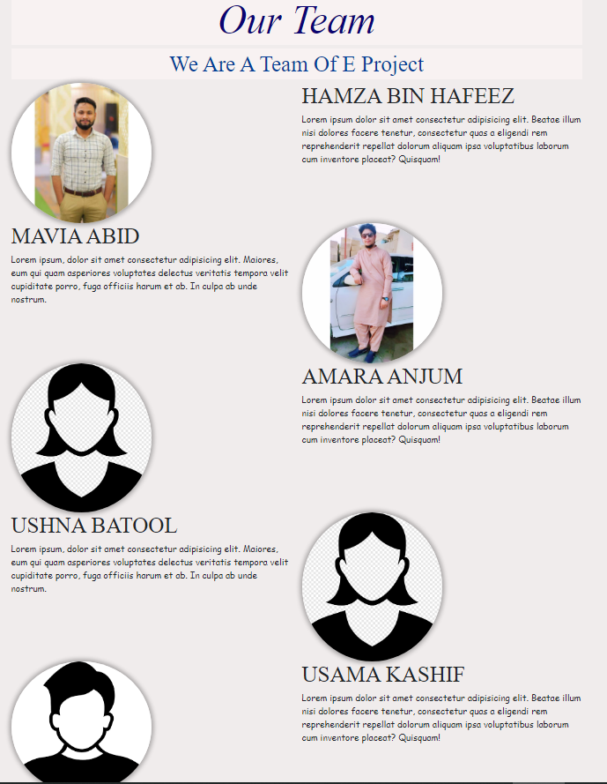


SOME VIEWS OF
BEAUTY OF BEACHES

Slide 11
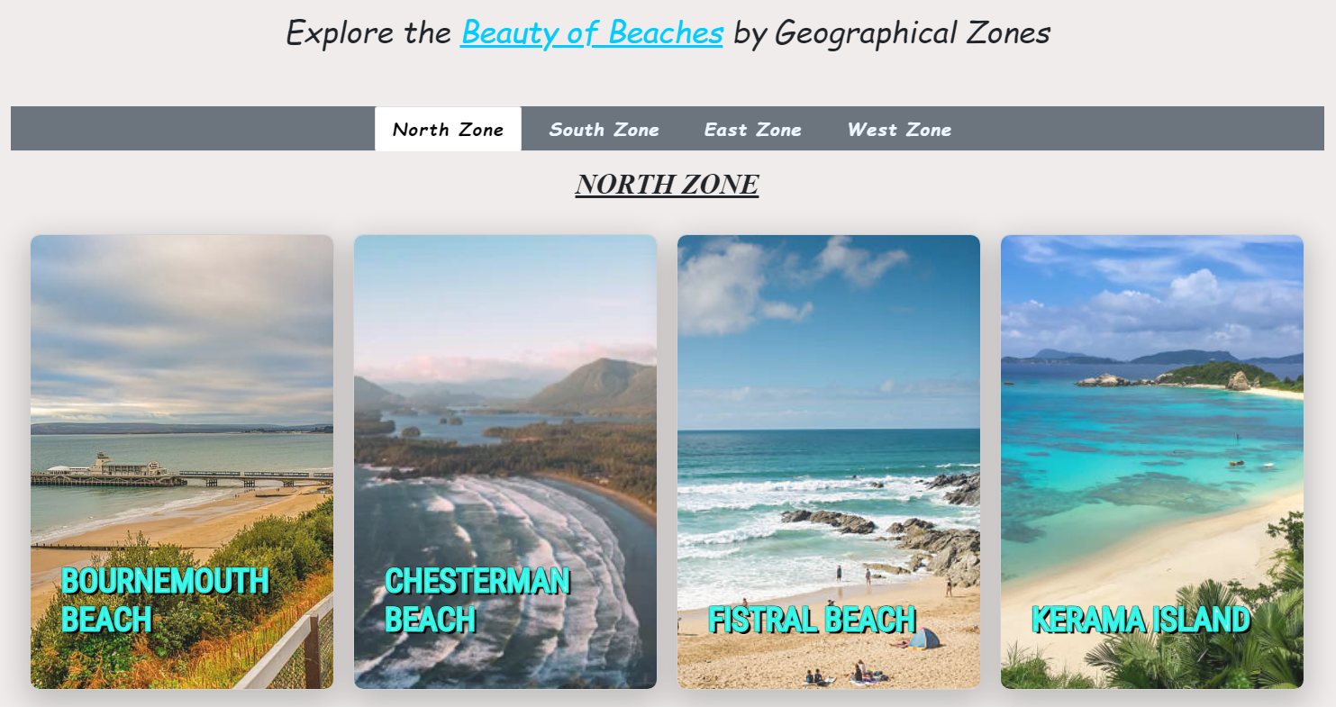

SOME VIEWS OF
BEAUTY OF BEACHES

Slide 12
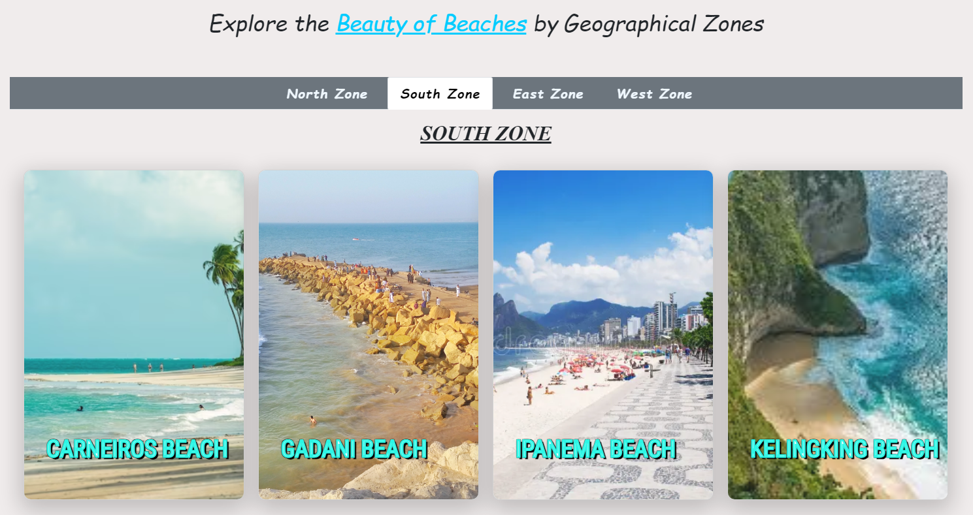

SOME VIEWS OF
BEAUTY OF BEACHES

Slide 13
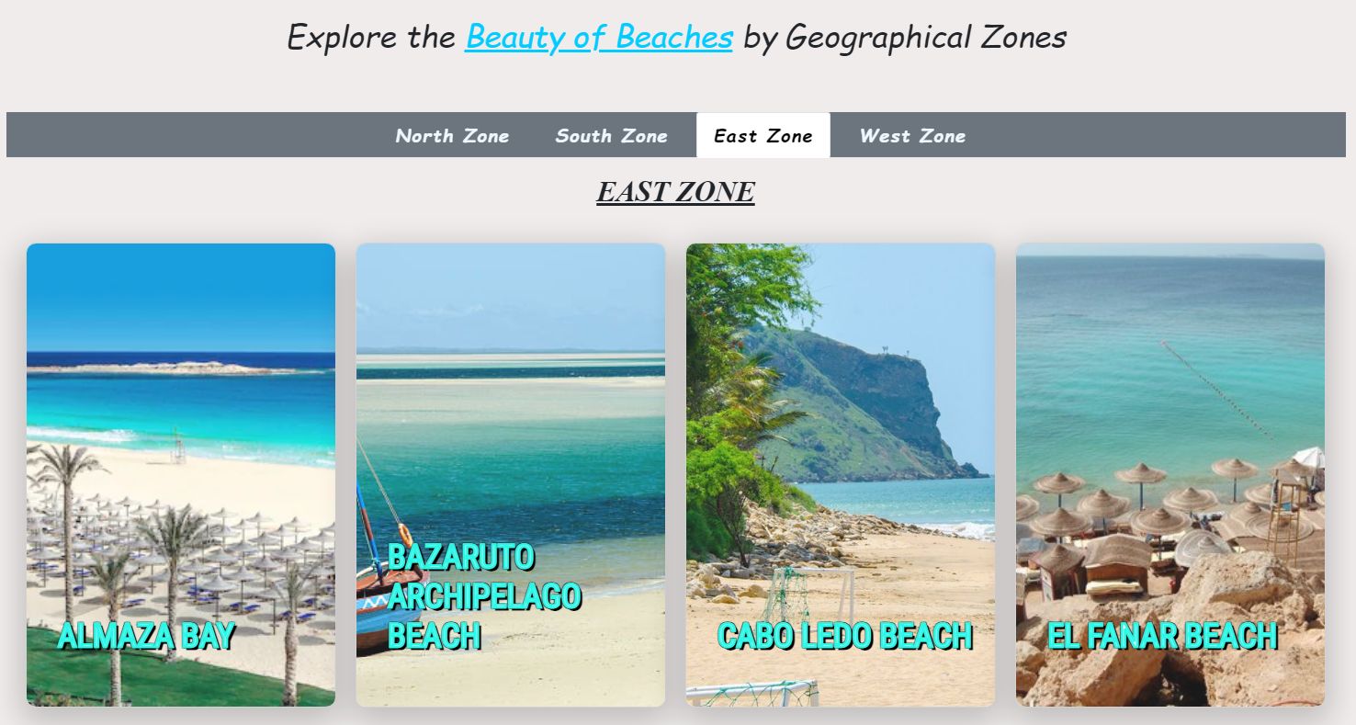

SOME VIEWS OF
BEAUTY OF BEACHES

Slide 14
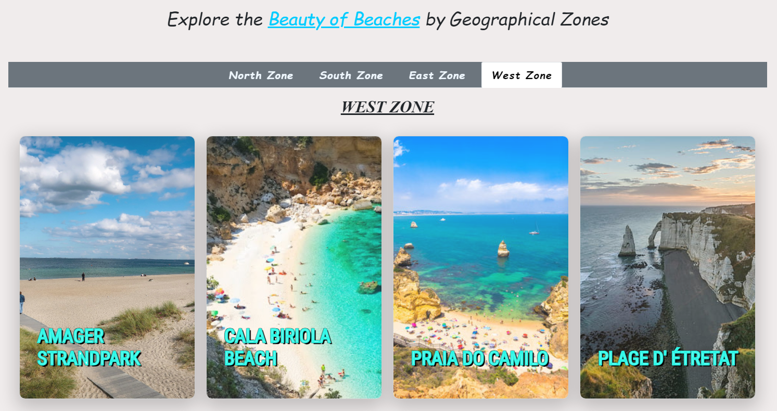

SOME VIEWS OF
BEAUTY OF BEACHES

Slide 15
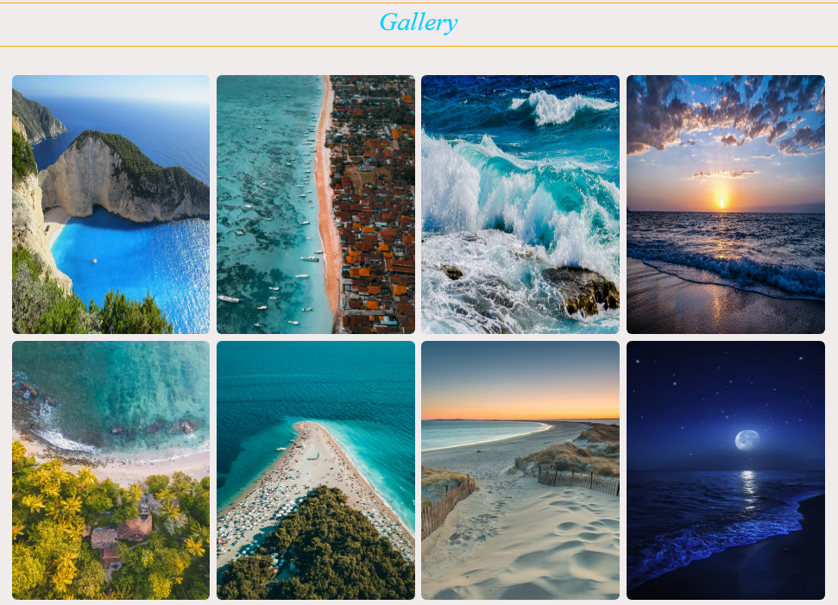


SOME VIEWS OF
BEAUTY OF BEACHES

Slide 16
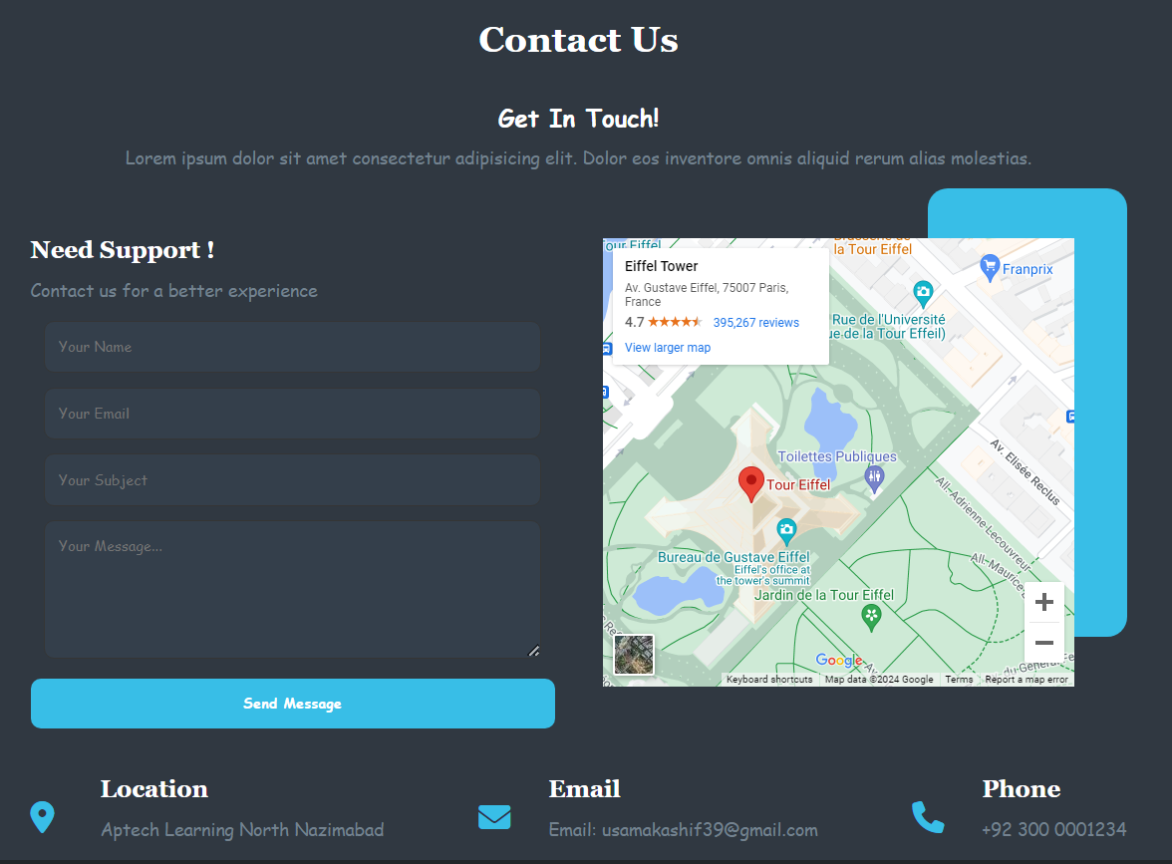
SOME VIEWS OF
BEAUTY OF BEACHES

Slide 17

SOME VIEWS OF
BEAUTY OF BEACHES
Feedback/Rating Page

Slide 18
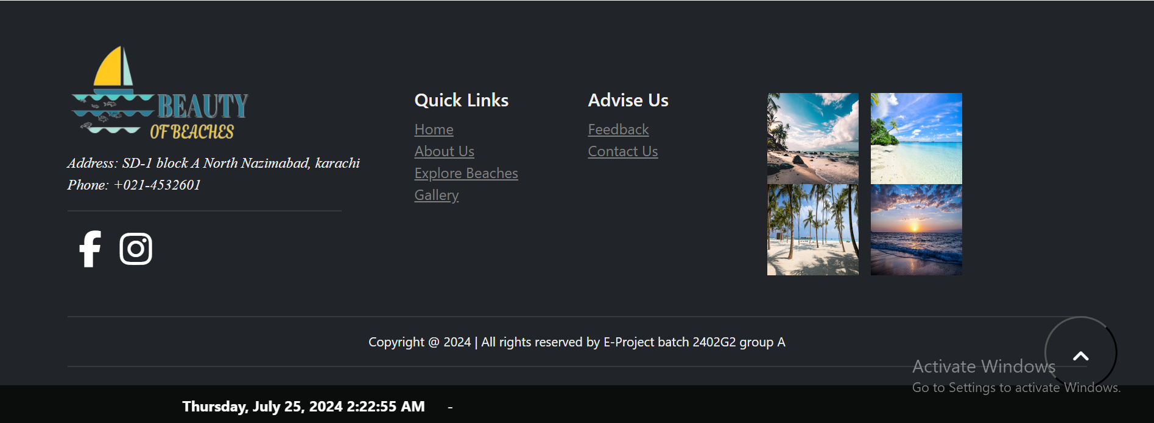

SOME VIEWS OF
BEAUTY OF BEACHES
Footer

Slide 19
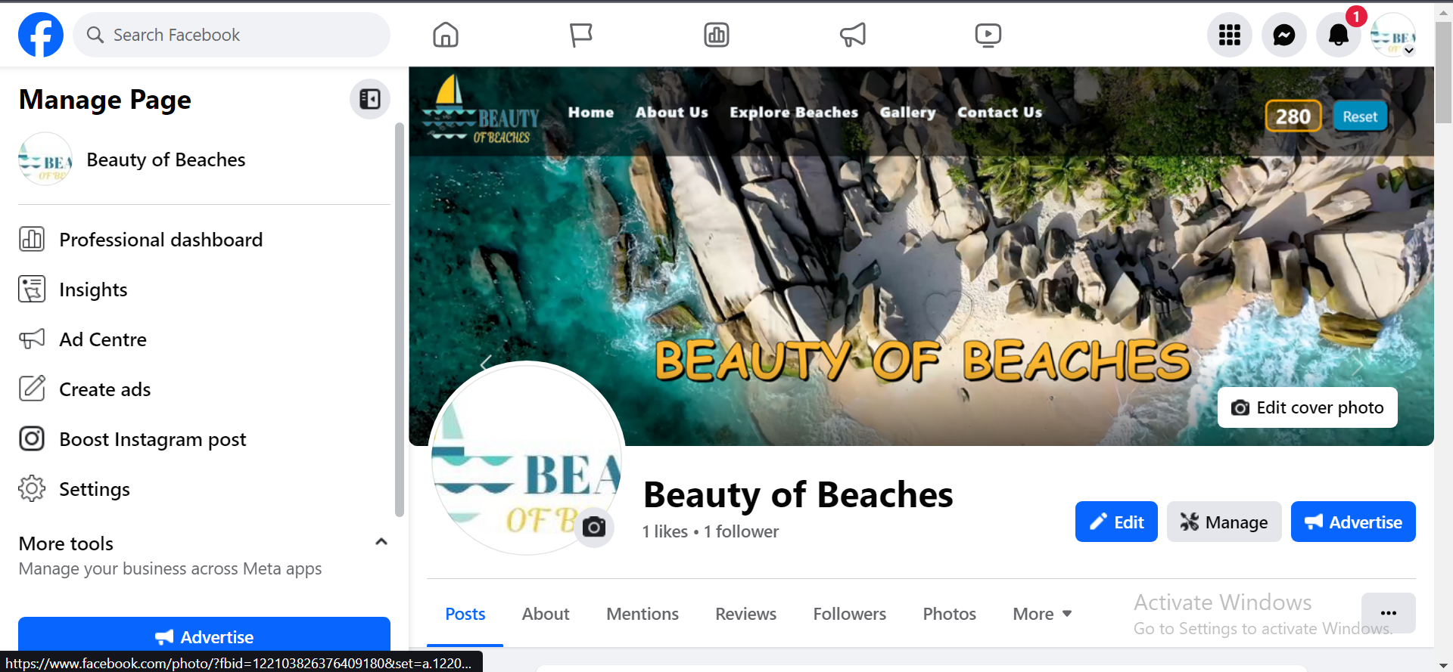
SOME VIEWS OF
BEAUTY OF BEACHES

Slide 20
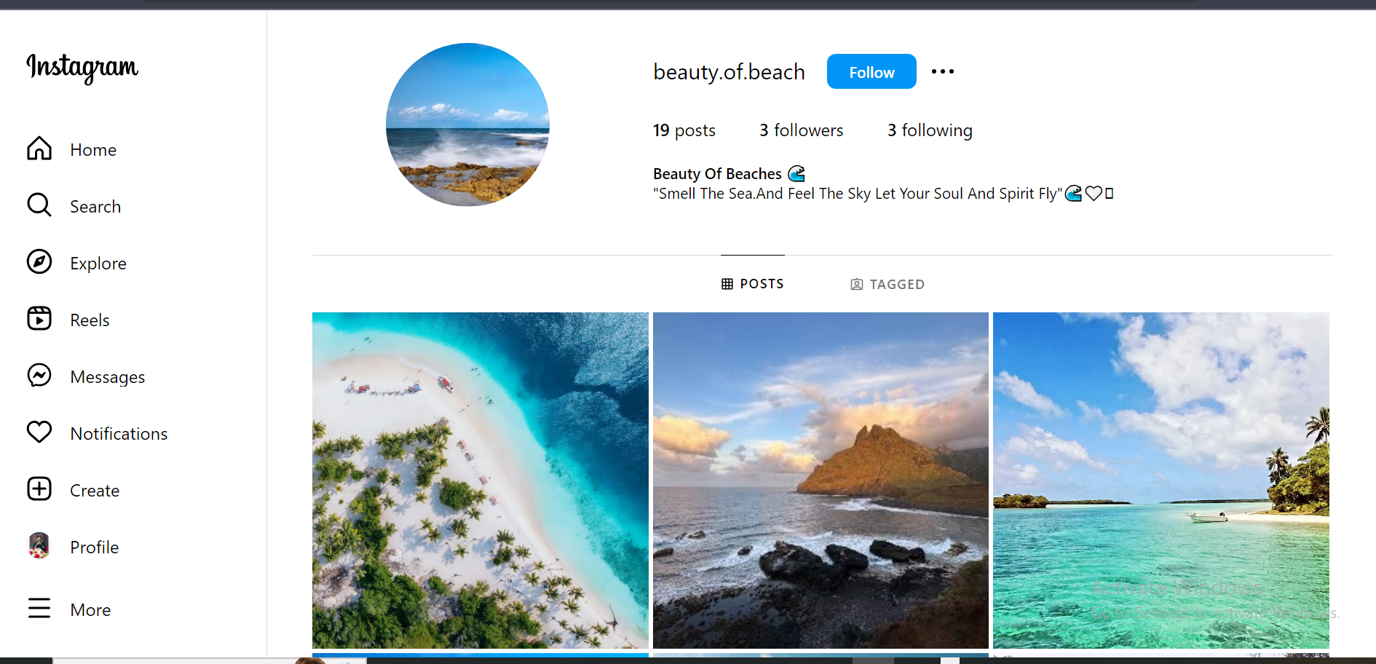
SOME VIEWS OF
BEAUTY OF BEACHES

Slide 21
BEAUTY OF BEACHES
THANK YOU!

